Slide 1

Final Project Face Recognition
Rezvanian, Tina
CSCI E-89 Deep Learning, Spring 2020
Harvard University Extension School
Prof. Zoran B. Djordjević

Slide 2
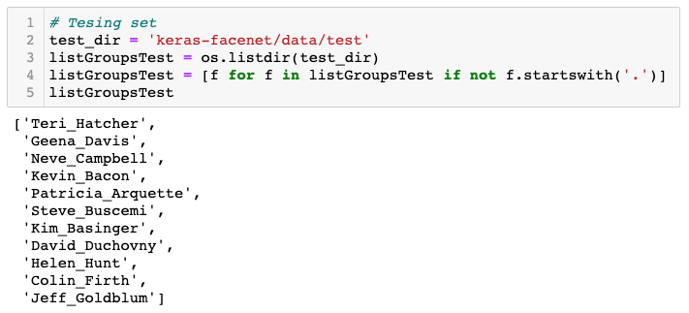
Introduction
Face Recognition: Matching faces in images to one of the known subjects in database
Data set: Selected 11 classes of publicly available CASIA-WebFace dataset, created by Institute of Automation, Chinese Academy of Sciences (CASIA) from IMDb profiles. CASIA WebFace Facial dataset includes 494,414 images over 10,575 identities.
Divided data set into train, validation, test sets. Select one image from each class of the test folder for illustration and visualization purposes.
Set up environment and softwires
conda create -n DLpy37 python=3.7.6 anaconda
conda activate DLpy37
pip install tensorflow
pip install keras
sudo pip install git+https://github.com/rcmalli/keras-vggface.git
pip install -r requirements.txt :numpy, opencv-python …

Slide 3
Overview
VGG16
ResNet50
Data Augmentation
Regularization
Prediction using existing pretrained models
Feature Extraction
VGG16
ResNet50
Transfer Learning
VGG16_1layer
Improve existing pretrained models
VGG16_2Layers
ResNet50 1Layer
Face Recognition
ResNet50_2layers
Fine Tuning
VGG16
ResNet50
Add another person to database/ image Not in database/ database include only one image per person
Embedding Extraction and Comparison
FaceNet
Multiple faces in an image

Slide 4
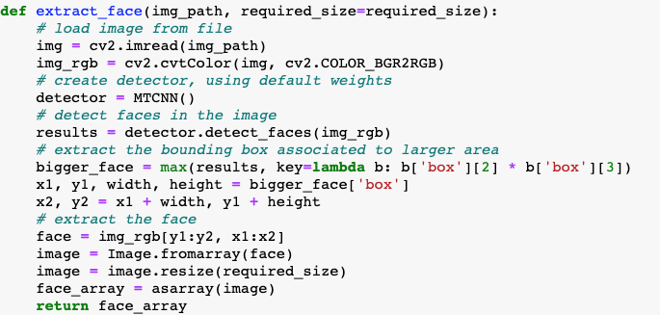
Preparation
Using pretrained models needs extraction of faces from images (package mtcnn==0.1.0)
Data images may include more than one face
Extract face with larger area

Slide 5
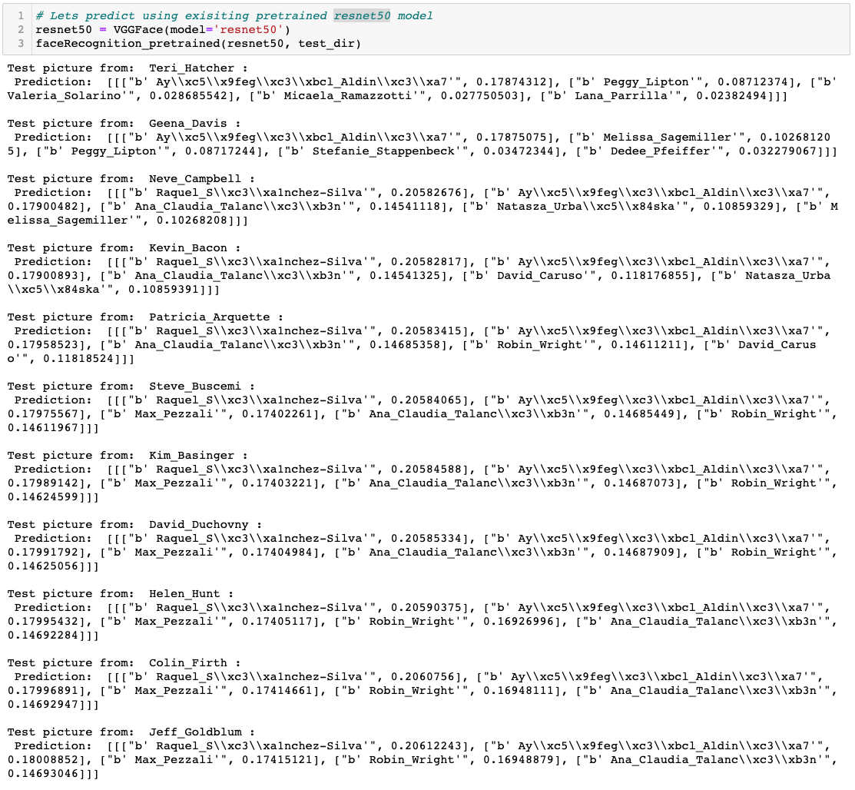
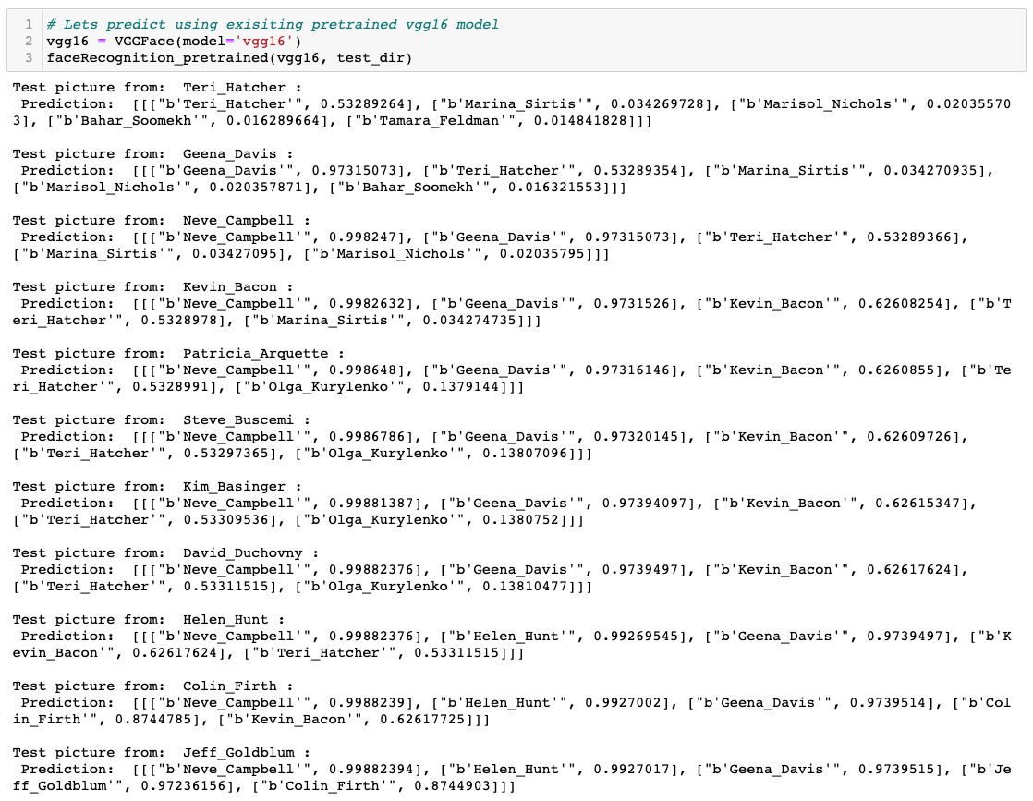
Prediction using Existing Pretrained FR Models
Create a folder of candidate images from 11 celebrities
VGGFace models: VGG16 and Resnet50 models trained on the VGGFace2 and dataset are downloaded from keras_vggface
VGGFace2 dataset, developed by researchers at the Visual Geometry Group at Oxford, includes faces across different poses and ages. The whole dataset contains 9131 celebrities
Although VGGFace2 includes all 11 subjects in its classes, VGG16 and Resnet50 models trained on this dataset cannot correctly classify the faces!
VGG16 and ResNet50 models correctly identify 3 and 0 faces out of 11 faces respectively

Slide 6
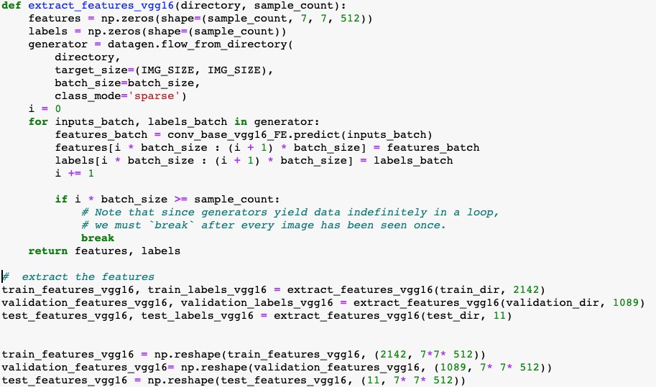
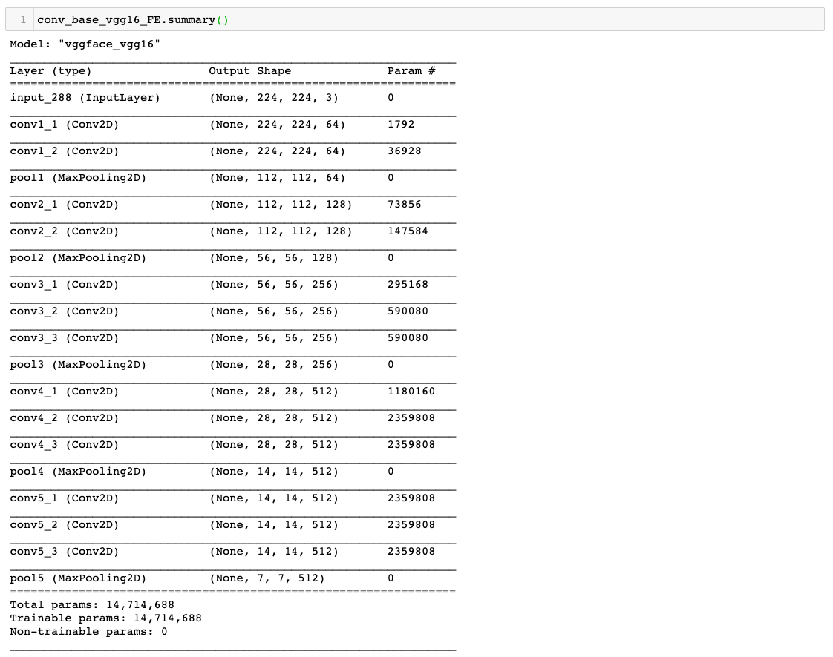
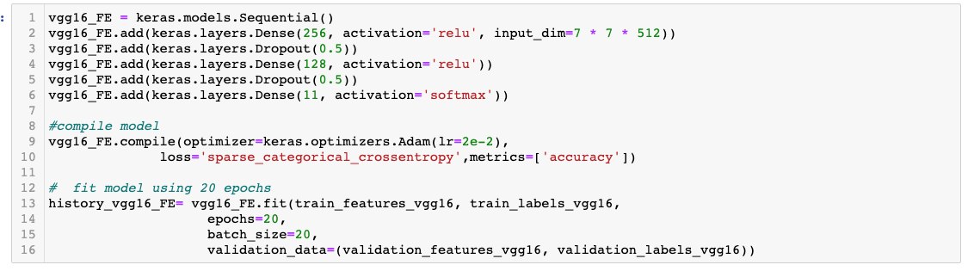
Feature Extraction
Extract features and labels in train, validation, and test folders by predicting from the convolutional base of the VGGFace models
Created models using the extracted features
Reshape them to be inputted into a model with dense layers
Use dropouts and regularizes for regularization to avoid overfitting
Training is set twice size of validation set

Slide 7
Feature Extraction
VGG16:
val_loss: 0.0432
val_accuracy: 0.9844
ResNet50:
val_loss: 0.1199
val_accuracy: 0.9862
Validation and training accuracy remain constant

Slide 8
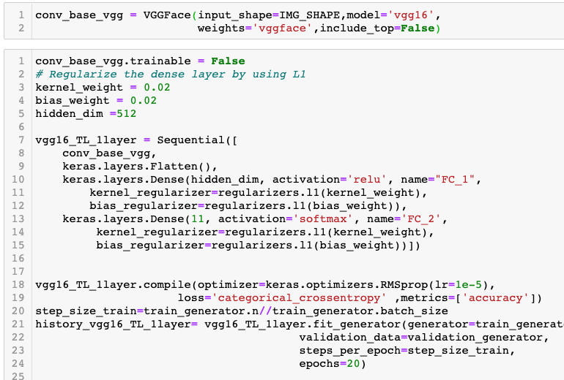
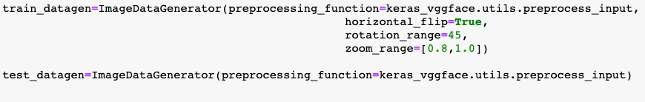
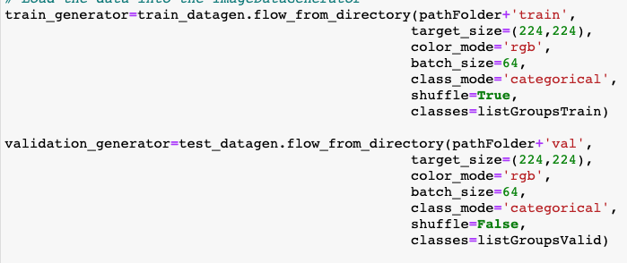
Transfer Learning
Build a model on top of the convolutional base of the VGG16 and ResNet50
Freeze the parameters of the convolutional base
Train parameters in added hidden dense and classifier layers
Use dropouts and regularizes for regularization to avoid overfitting
Images are augmented based on horizontal flip, 45 rotation, and zooming for training. The validation images are not augmented.

Slide 9
Transfer Learning (VGG16)
Adding 1 hidden dense layer
val_loss: 829.0189
val_accuracy: 0.9458
Adding 2 hidden Dense layers
val_loss: 934.8681
val_accuracy: 0.9403
VGG16 models yield similar accuracy when 1 or 2 hidden dense layers are added

Slide 10
Transfer Learning (ResNet50)
Adding 1 hidden dense layer
val_loss: 395.7479
val_accuracy: 0.7603
Adding 2 hidden Dense layers
val_loss: 173.6574
val_accuracy: 0.9440
Adding 2 hidden dense layers significantly improved the accuracy and the performance of the model created on Resnet50's convolutional base

Slide 11
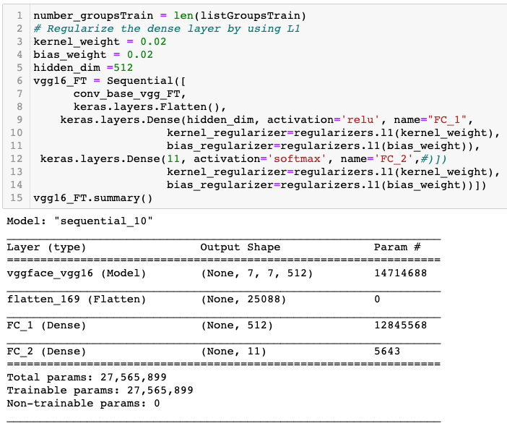
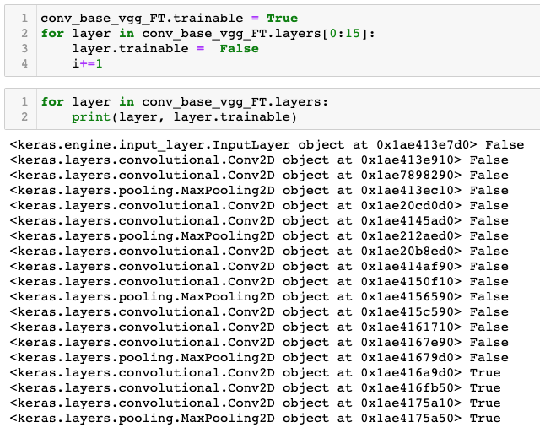
Fine Tuning
Build a model on top of the convolutional base of the VGG16 and ResNet50
Only unfreeze the parameters of all layers in the last convolutional block
The remaining layers in convolutional base are frozen
Train parameters in the last convolutional block, added dense and classification layers
Use regularizes for regularization to avoid overfitting

Slide 12
Fine Tuning
VGG16:
val_loss: 733.7641 - val_accuracy: 0.9568
ResNet50:
val_loss 384.0705
val_accuracy: 0.9706
Accuracies improved compared to transfer learning
Greater improvement in model using ResNet50

Slide 13
Illustration of TL an FT models
All TL and FT models correctly classified candidate images
How about less lear images?

Slide 14
Multiple faces in an image
resnet50_TL_1layer.h5
vgg16_TL_1layer.h5
Less clear image
Multiple faces
Face not in database
Resnet50 misclassifies
more than VGG16
resnet50_TL.h5
vgg16_TL.h5
Classification of faces not in data base changes across models
resnet50_FT.h5
vgg16_FT.h5

Slide 15
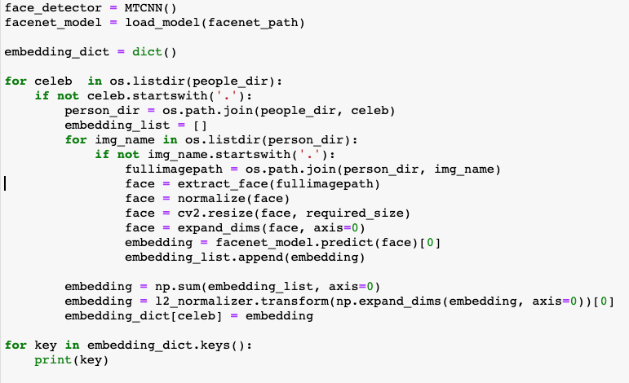
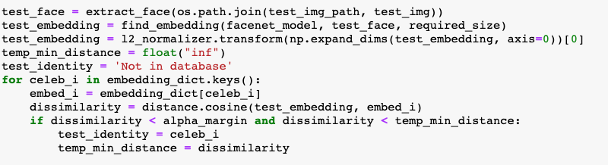
Add another person/person not in database
Need to retrain created models to include the new person or other in the classes
What is we only have one image per person in our database?
FaceNet model developed by Google and was trained on MS-Celeb-1M dataset
Create a people directory including one image per subject as our new database
Get the embeddings of each face in our database
Find the embedding of candidate face in the example test images
If distance between the test face embedding and extracted embeddings from database is less that a pre-defined margin and that person’s distance with its own image, then the face in test image is recognized

Slide 16
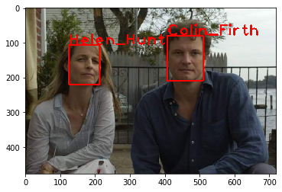
FaceNet Predictions
Less clear image
Multiple faces
Face not in database
All Correct
vgg16_TL.h5
resnet50_FT.h5

Slide 17
Lessons Learned & Pros/Cons:
Repurposing existing models, using a moderate size dataset, to match an extracted face to a known individual can significantly improve the prediction accuracy of pretrained models.
The performance of repurposed models strongly depends on the underlying network architecture and not necessarily the depth or number of layers. VGG16 yields higher validation accuracy with less layers retrained. VGG16 and Resnet50 models are both pretrained on the same VGGFace2 dataset. However, when more of the layers are retrained, model using ResNet50 improved more.
The performance of repurposed models strongly depends on the number of images in the underlying datasets and the learning algorithm of pretrained models. Repurposing FaceNet model with 1 million identities and one-shot learning algorithm strongly over performs repurposed models using VGG16 and ResNet50 with 9,131 identities that use many images per identity.
Fine tuning improved the validation accuracies more than transfer learning using models’ convolutional bases.
Models using VGG16’s convolutional base responded better than ReNet50 to the transfer learning when 1 or 2 layers added. Model using ReNet50’s convolutional base achieved the same accuracy by adding 2 hidden layers.
Model using Resnet50’s convolutional base responded better than VGG16 to finetuning.

Slide 18
YouTube URLs, Last Page
Short video: https://www.youtube.com/watch?v=JfPWQ8RJ6LM
Long video: https://www.youtube.com/watch?v=wrOLiOygwJU

